Slide 1
Health Professions Advisory Group
Information Session
September 22, 2022

Slide 2
Interested in Health Care? Join SIHC Club!
Students Interested in Health Careers (SIHC) Club
Our Goals:
Create a positive pre-health environment on campus
Meet other pre-health students
Connect students with mentors
Discuss how to build your resumé
Invite professionals from the community to talk/hang out
★ Get free food from HealthPAG
Medical, Physician Assistant, Physical Therapy, Occupational Therapy, Nursing School, Public Health, Dental, Vet, Pharmacy, or general interest in a health care profession.

Slide 3
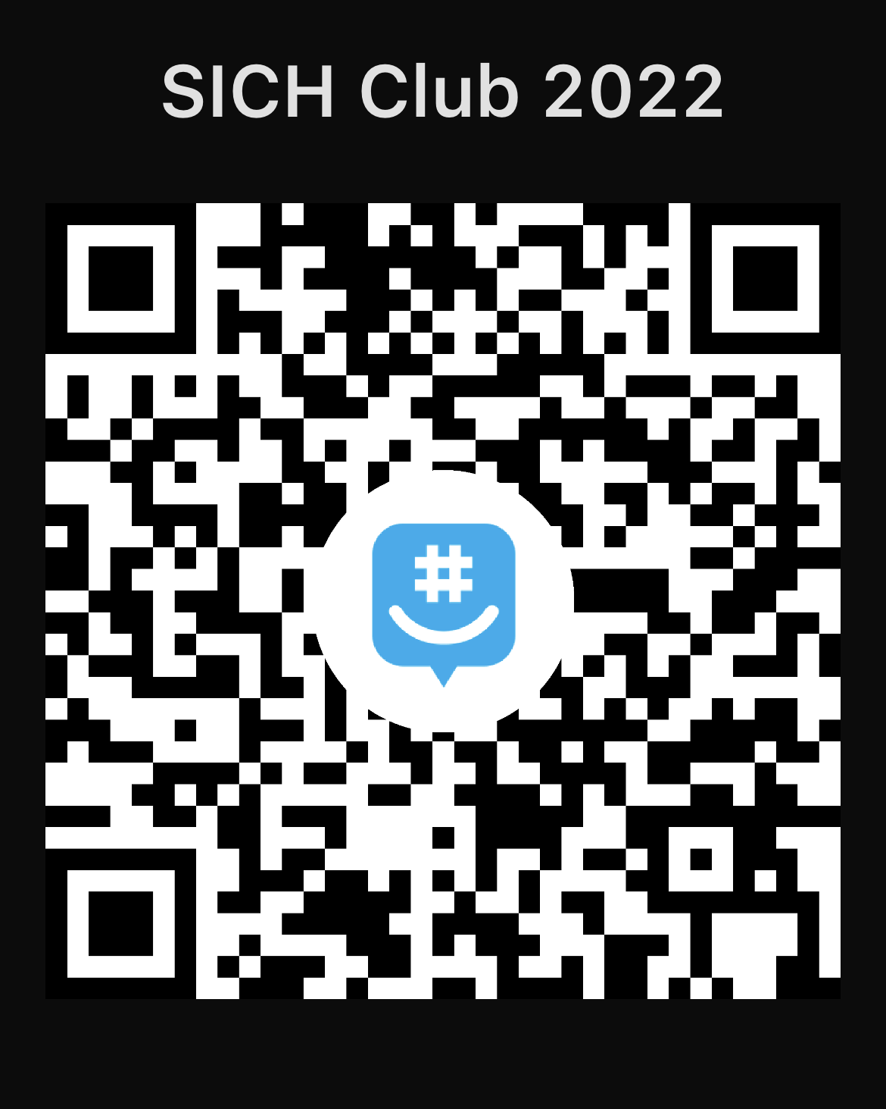
GroupMe QR Code

Slide 4
What can HealthPAG do for you?
Guide you through the 4-year process of pursuing a future in the health professions
Write a committee recommendation letter for your file
Conduct mock interviews
Offer advice and answer questions along the way
Provide feedback on your application materials, including your personal statement.

Slide 5
Members of HealthPAG
Dr. Angela Allen | Psychology
Dr. Shannon Anderson | Sociology & Public Health
Dr. Brooks Crozier | Biology
Dr. Gary Hollis | Chemistry
Dr. Len Pysh | Biology

Slide 6
Where to find us…
Make an appointment with ANY of us via email
Contact Mrs. Debbie Duncan, secretary
duncan@roanoke.edu
540-375-2441
4th floor Trexler (Chemistry)

Slide 7
What Major is Best for Me?
You should pick the major that is the most interesting for you
Graduate programs in the health professions are attracted to candidates with a range of backgrounds. You do not have to major in science!
Many programs value majors/minors/concentrations outside of the sciences
Whatever your major, know your pre-reqs!

Slide 8
Key Criteria for Graduate/ Professional School:
Grades
Shadowing, Volunteering, Interning, Research
Rec Letters
Interview Process
Tests—MCAT, PCAT, DAT, GRE
Notes:
Would it make sense to include internships and research experiences here?

Slide 9
What are schools looking for?
Almost all professional schools require a GPA higher than 3.0.
A typical successful applicant has mostly A’s and B’s, with more A’s than B’s, both in and out of science.
If you have a rough freshmen year, you might just require a couple years of working in your area to build your case before grad/professional school.
Notes:
In and out of sciences and their majors/minors/concentrations

Slide 10
Grades and Admission Success Rates for Roanoke Students
The following GPAs are both in science and overall:
Veterinary School: 3.7 or higher = 100% success rate
Physical Therapy: 3.5 or higher = 100% success rate
Medical School: 3.5 or higher = 97% success rate
Dental School: 3.4 or higher = 100% success rate
Occupational Therapy: 3.4 or higher = 100% success rate
Physician Assistant School: 3.3 or higher = 100%
Public Health: 3.3 or higher = 100% success rate
Pharmacy School: 3.0 or higher = 100% success rate
Nursing: 3.0 or higher = 100% success rate
Success rates drop off quickly at lower GPAs and multiple gap years are often necessary for students who are successful in their applications.
Notes:
Add School of Public Health—I don’t have numbers for here, but generally 3.25 or higher would get students in at 90% from looking online

Slide 11
Average Scores
MCAT: 50%-97% (500-518 on 528 scale)
PCAT: ~400-500 (scale of 600), 65-90 (percentile)
DAT: 18-25 (scale of 30)
GRE: Field dependent
Notes:
Better MPH programs: 80% and higher
PCAT: Appalachian ~ 65; VCU = 70 (minimum)
DAT: VCU = 19.5, Harvard = 24.4

Slide 12
First Look at Timeline
Junior year: Testing! (and more)
MCAT: May Junior Year
DAT: Summer after Junior year
PCAT: Summer after Junior year
GRE: Late-Junior/early-Senior (depending on program)
Choosing your schools
Before and during senior year
Letters of recommendation
Essay writing
Getting the applications submitted ON TIME

Slide 13
Roanoke Connections in the Area
Shadowing agreement with Carilion
Roanoke College clinical research course taught at Carilion
Clinical research internships at the Veterans Administration Hospital
Volunteer agreements with the Bradley Free Clinic and Rescue Mission
Volunteer agreement with the Roanoke Zoo
Multiple scribing organizations in the area
Bradley Free Clinic

Slide 14
Other Resources
AED – Pre-Medical Honor Society
Advisor: Dr. Crozier
SIHC – Students Interested in Health Careers
President: Eddie Dixon

Slide 15
So what should you do?
Take the steps necessary to position yourself for future success. This includes:
Working hard in your classes: when it comes to GPA, higher is definitely better. (Don’t be afraid to ask for help!)
Getting to know your faculty—not just your science faculty
Talking with the juniors and seniors who are pursuing the path you want to follow
Finding research, shadowing, internships and other out-of-the-classroom opportunities
Joining student organizations!
Keeping HealthPAG informed and come to events (even those not related to the specialty you think you want to pursue.)
Thinking carefully about your career goals and becoming informed about the requirements to pursue those goals

Slide 16
Carefully Consider Your Postings to Social Media (what not to do!)
Directors of admission WILL check your social media profile
Snapchat
TikTok
Instagram
Facebook
Twitter
The ones we might not know!

Slide 17
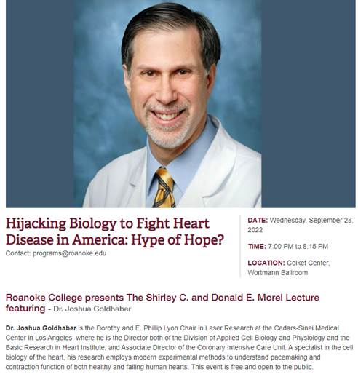
Morel lecture—Next Wednesday!

